Slide 1
Biological Modeling of Neural Networks
Week 3 – part 1 : Reduction of the Hodgkin-Huxley Model
3.1 From Hodgkin-Huxley to 2D
- Overview: From 4 to 2 dimensions
- MathDetour 1: Exploiting similarities
- MathDetour 2: Separation of time scales
3.2 Phase Plane Analysis
- Role of nullclines
3.3 Analysis of a 2D Neuron Model
- constant input vs pulse input
- MathDetour 3: Stability of fixed points
3.4 TypeI and II Neuron Models
next week!
Week 3 – Reducing detail:
Two-dimensional neuron models
Wulfram Gerstner
EPFL, Lausanne, Switzerland

Slide 2
Neuronal Dynamics – 3.1. Review :Hodgkin-Huxley Model
cortical neuron
Hodgkin-Huxley model
→Compartmental models
Na⁺

Slide 3
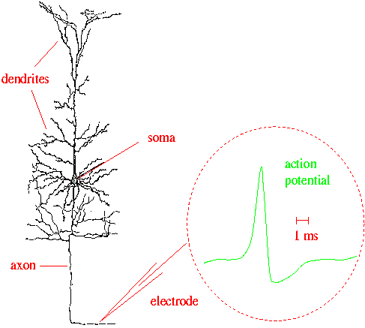
Neuronal Dynamics – 3.1 Review :Hodgkin-Huxley Model
Week 2:
Cell membrane contains
- ion channels
- ion pumps
Dendrites (week 4):
Active processes?
assumption:
passive dendrite
→ point neuron
spike generation
-70mV
Na⁺
action
potential
K⁺
Ca²⁺
Ions/proteins

Slide 4
Neuronal Dynamics – 3.1. Review :Hodgkin-Huxley Model
inside
100
Ka
K
mV
Na
outside
0
Ion channels
Ion pump
Reversal potential
ion pumps →concentration difference ⬄ voltage difference

Slide 5
Neuronal Dynamics – 3.1. Review: Hodgkin-Huxley Model
Hodgkin and Huxley, 1952
100
inside
I
Ka
C
mV
g_{K}
g_{l}
g_{Na}
Na
0
outside
Ion channels
Ion pump
stimulus
4 equations
= 4D system
n₀(u)
u
u

Slide 6
Neuronal Dynamics – 3.1. Overview and aims
Can we understand the dynamics of the HH model?
- mathematical principle of Action Potential generation?
- constant input current vs pulse input?
- Types of neuron model (type I and II)? (next week)
- threshold behavior? (next week)
→ Reduce from 4 to 2 equations
Type I and type II models
ramp input/
constant input
f-I curve
f-I curve
f
f
I0
I0
I0

Slide 7
Neuronal Dynamics – 3.1. Overview and aims
Can we understand the dynamics of the HH model?
→ Reduce from 4 to 2 equations

Slide 8
Neuronal Dynamics – Quiz 3.1.
A - A biophysical point neuron model
with 3 ion channels,
each with activation and inactivation,
has a total number of equations equal to
[ ] 3 or
[ ] 4 or
[ ] 6 or
[ ] 7 or
[ ] 8 or more

Slide 9
Neuronal Dynamics – 3.1. Overview and aims
Toward a
two-dimensional neuron model
Reduction of Hodgkin-Huxley to 2 dimension
-step 1: separation of time scales
-step 2: exploit similarities/correlations

Slide 10
Neuronal Dynamics – 3.1. Reduction of Hodgkin-Huxley model
stimulus
m₀(u)
h₀(u)
u
u
MathDetour
1) dynamics of m are fast

Slide 11
Neuronal Dynamics – MathDetour 3.1: Separation of time scales
Two coupled differential equations
Exercise 1 (week 3)
(later !)
Separation of time scales
Reduced 1-dimensional system
Na⁺

Slide 12
Neuronal Dynamics – 3.1. Reduction of Hodgkin-Huxley model
stimulus
n₀(u)
h₀(u)
u
u
1) dynamics of m are fast
2) dynamics of h and n are similar

Slide 13
Neuronal Dynamics – 3.1. Reduction of Hodgkin-Huxley model
Reduction of Hodgkin-Huxley
Model to 2 Dimension
-step 1:
separation of time scales
-step 2:
exploit similarities/correlations
Now !

Slide 14
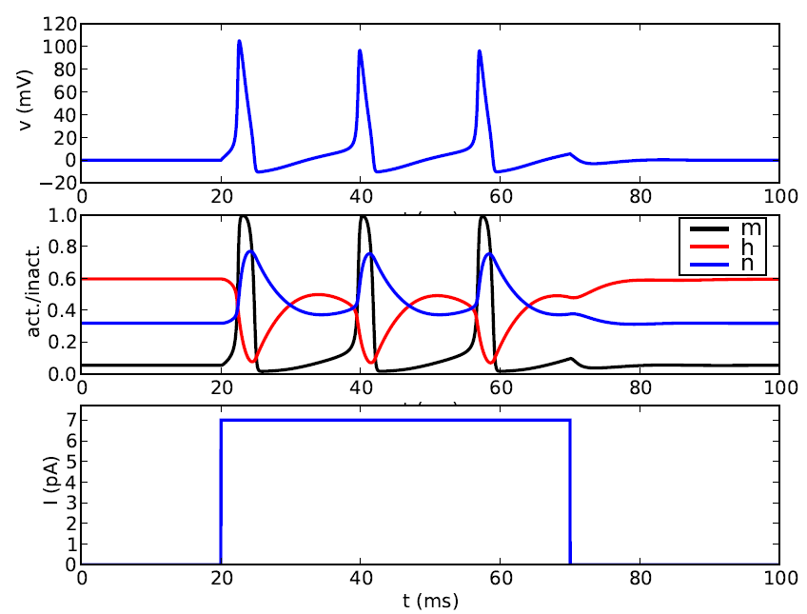
Neuronal Dynamics – 3.1. Reduction of Hodgkin-Huxley model
stimulus
2) dynamics of h and n are similar
MathDetour
u
t
1
hrest
h(t)
nrest
n(t)
0
t

Slide 15
Neuronal Dynamics – Detour 3.1. Exploit similarities/correlations
dynamics of h and n are similar
h
1-h
Math. argument
n
1
hrest
h(t)
nrest
n(t)
0
t

Slide 16
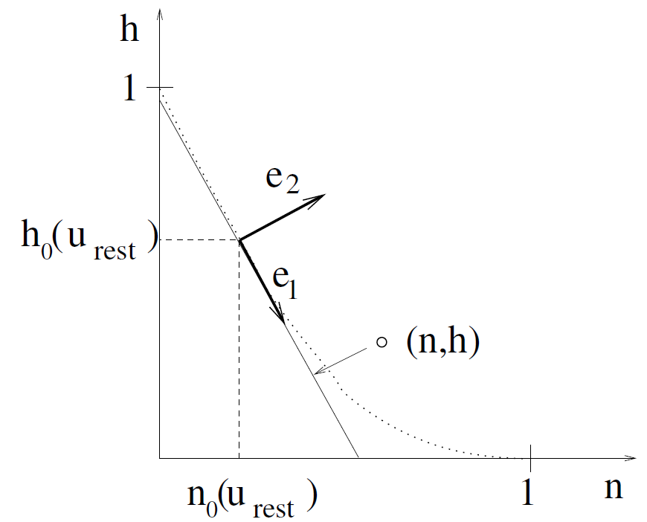
Neuronal Dynamics – Detour 3.1. Exploit similarities/correlations
dynamics of h and n are similar
at rest
n
1
hrest
h(t)
nrest
n(t)
0
t

Slide 17
Neuronal Dynamics – Detour 3.1. Exploit similarities/correlations
dynamics of h and n are similar
Rotate coordinate system
Suppress one coordinate
Express dynamics in new variable
n
1
hrest
h(t)
nrest
n(t)
0
t

Slide 18
Neuronal Dynamics – 3.1. Reduction of Hodgkin-Huxley model
1) dynamics of m are fast
2) dynamics of h and n are similar
w(t)
w(t)

Slide 19
Neuronal Dynamics – 3.1. Reduction of Hodgkin-Huxley model

Slide 20
NOW Exercise 1.1-1.4: separation of time scales
A:
- calculate x(t)!
- what if τ is small?
0
1
t
Exercises:
1.1-1.4 now!
1.5 homework
?
t
Exerc. 9h50-10h00
Next lecture:
10h15
B: -calculate m(t)
if τ is small!
- reduce to 1 eq.

Slide 21
Biological Modeling of Neural Networks
Week 3 – part 1 : Reduction of the Hodgkin-Huxley Model
3.1 From Hodgkin-Huxley to 2D
- Overview: From 4 to 2 dimensions
- MathDetour 1: Exploiting similarities
- MathDetour 2: Separation of time scales
3.2 Phase Plane Analysis
- Role of nullclines
3.3 Analysis of a 2D Neuron Model
- constant input vs pulse input
- MathDetour 3: Stability of fixed points
3.4 TypeI and II Neuron Models
next week!
Week 3 – Reducing detail:
Two-dimensional neuron models
Wulfram Gerstner
EPFL, Lausanne, Switzerland

Slide 22
Neuronal Dynamics – MathDetour 3.1: Separation of time scales
Two coupled differential equations
Ex. 1-A
Exercise 1 (week 3)
Separation of time scales
Reduced 1-dimensional system
Na⁺

Slide 23
Neuronal Dynamics – MathDetour 3.2: Separation of time scales
Linear differential equation
step

Slide 24
Neuronal Dynamics – MathDetour 3.2 Separation of time scales
Two coupled differential equations
x
c
‘slow drive’
I
Na⁺

Slide 25
Neuronal Dynamics – Reduction of Hodgkin-Huxley model
stimulus
n₀(u)
h₀(u)
u
u
dynamics of m is fast
Fast compared to what?

Slide 26
Neuronal Dynamics – MathDetour 3.2: Separation of time scales
Two coupled differential equations
Exercise 1 (week 3)
even more general
Separation of time scales
Reduced 1-dimensional system
Na⁺

Slide 27
Neuronal Dynamics – Quiz 3.2.
A- Separation of time scales:
We start with two equations
[ ] If then the system can be reduded to
[ ] If then the system can be reduded to
[ ] None of the above is correct.
Attention
I(t) can move rapidly,
therefore
choice [1]
not correct

Slide 28
Neuronal Dynamics – Quiz 3.2-similar dynamics
Exploiting similarities:
A sufficient condition to replace two gating variables r,s
by a single gating variable w is
[ ] Both r and s have the same time constant (as a function of u)
[ ] Both r and s have the same activation function
[ ] Both r and s have the same time constant (as a function of u)
AND the same activation function
[ ] Both r and s have the same time constant (as a function of u)
AND activation functions that are identical after some additive rescaling
[ ] Both r and s have the same time constant (as a function of u)
AND activation functions that are identical after some multiplicative
rescaling

Slide 29
Neuronal Dynamics – 3.1. Reduction to 2 dimensions
2-dimensional equation
Enables graphical analysis!
Phase plane analysis
-Discussion of threshold
- Constant input current vs pulse input
-Type I and II
- Repetitive firing

Slide 30
Biological Modeling of Neural Networks
Week 3 – part 1 : Reduction of the Hodgkin-Huxley Model
3.1 From Hodgkin-Huxley to 2D
- Overview: From 4 to 2 dimensions
- MathDetour 1: Exploiting similarities
- MathDetour 2: Separation of time scales
3.2 Phase Plane Analysis
- Role of nullclines
3.3 Analysis of a 2D Neuron Model
- constant input vs pulse input
- MathDetour 3: Stability of fixed points
3.4 TypeI and II Neuron Models
next week!
Week 3 – Reducing detail:
Two-dimensional neuron models
Wulfram Gerstner
EPFL, Lausanne, Switzerland

Slide 31
Neuronal Dynamics – 3.2. Reduced Hodgkin-Huxley model
stimulus

Slide 32
Neuronal Dynamics – 3.2. Phase Plane Analysis/nullclines
2-dimensional equation
stimulus
Enables graphical analysis!
u-nullcline
-Discussion of threshold
-Type I and II
w-nullcline

Slide 33
Neuronal Dynamics – 3.2. FitzHugh-Nagumo Model
MathAnalysis,
blackboard
u-nullcline
w-nullcline
Notes:
We set b0=b1-2

Slide 34
Neuronal Dynamics – 3.2. flow arrows
Stimulus I=0
w
Consider change in small time step
u
Flow on nullcline
I(t)=0
Flow in regions between nullclines
Stable fixed point

Slide 35
Neuronal Dynamics – Quiz 3.3
A. u-Nullclines
[ ] On the u-nullcline, arrows are always vertical
[ ] On the u-nullcline, arrows point always vertically upward
[ ] On the u-nullcline, arrows are always horizontal
[ ] On the u-nullcline, arrows point always to the left
[ ] On the u-nullcline, arrows point always to the right
B. w-Nullclines
[ ] On the w-nullcline, arrows are always vertical
[ ] On the w-nullcline, arrows point always vertically upward
[ ] On the w-nullcline, arrows are always horizontal
[ ] On the w-nullcline, arrows point always to the left
[ ] On the w-nullcline, arrows point always to the right
[ ] On the w-nullcline, arrows can point in an arbitrary direction
Take 1 minute,
continue at 10:55

Slide 36
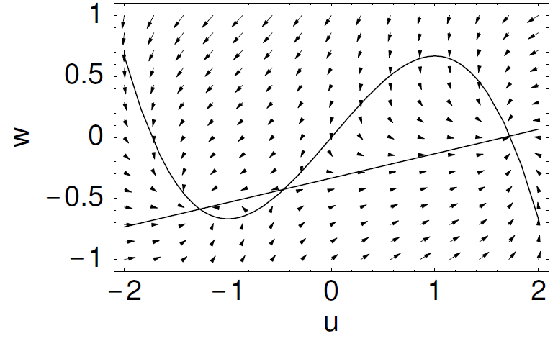
Neuronal Dynamics – 4.2. FitzHugh-Nagumo Model
change b1
Notes:
We set b0=b1-2

Slide 37
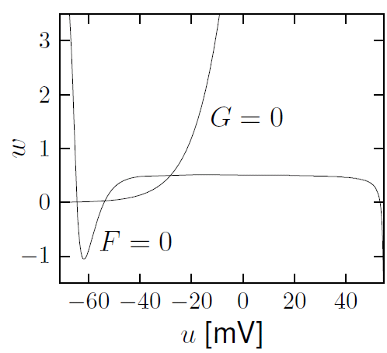
Neuronal Dynamics – 3.2. Nullclines of reduced HH model
stimulus
u-nullcline
w-nullcline
Stable fixed point

Slide 38
Neuronal Dynamics – 3.2. Phase Plane Analysis
2-dimensional equation
stimulus
Enables graphical analysis!
Application to
neuron models
Important role of
- nullclines
- flow arrows

Slide 39
Week 3 – part 3: Analysis of a 2D neuron model
3.1 From Hodgkin-Huxley to 2D
3.2 Phase Plane Analysis
- Role of nullcline
3.3 Analysis of a 2D Neuron Model
- pulse input
- constant input
-MathDetour 3: Stability of fixed points
3.4 Type I and II Neuron Models
(next week)

Slide 40
Neuronal Dynamics – 3.3. Analysis of a 2D neuron model
2-dimensional equation
stimulus
2 important input scenarios
- Pulse input
- Constant input
Enables graphical analysis!

Slide 41
Neuronal Dynamics – 3.3. 2D neuron model : Pulse input
pulse input

Slide 42
Neuronal Dynamics – 3.3. FitzHugh-Nagumo Model : Pulse input
w
I(t)=0
u
I(t)
Pulse input: jump of voltage
pulse input

Slide 43
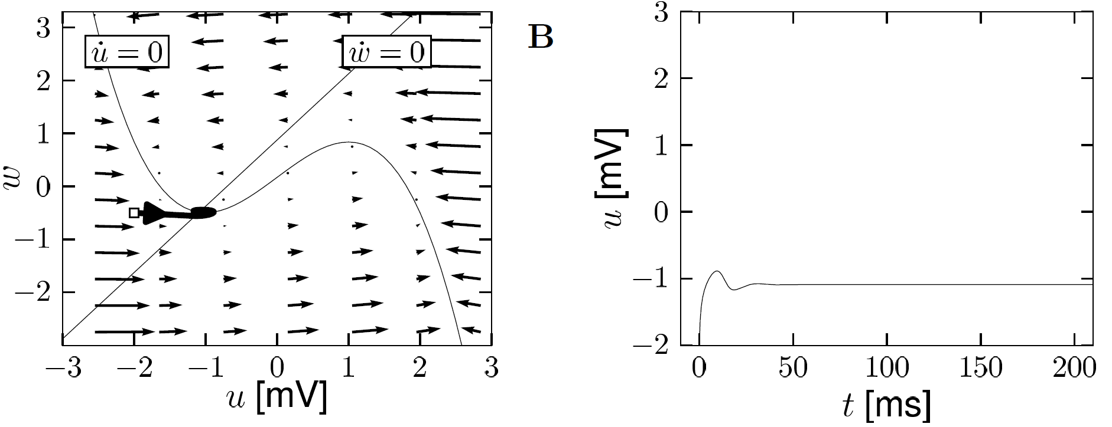
Neuronal Dynamics – 3.3. FitzHugh-Nagumo Model : Pulse input
FN model with
Image: Neuronal Dynamics,
Gerstner et al.,
Cambridge Univ. Press (2014)
Pulse input: jump of voltage/initial condition

Slide 44
Neuronal Dynamics – 3.3. FitzHugh-Nagumo Model
DONE!
Pulse input:
- jump of voltage
- ‘new initial condition’
- spike generation for large input pulses
w
I(t)=0
2 important input scenarios
constant input:
- graphics?
- spikes?
- repetitive firing?
u
Now

Slide 45
Neuronal Dynamics – 3.3. FitzHugh-Nagumo Model: Constant input
w
w-nullcline
I(t)=I₀
u
Intersection point (fixed point)
moves
changes Stability
u-nullcline

Slide 46
NOW Exercise 2.1: Stability of Fixed Point in 2D
w
- calculate stability
- compare
Exercises:
2.1now!
2.2 homework
I(t)=I₀
u
Next lecture:
11:42

Slide 47
Week 3 – part 3: Analysis of a 2D neuron model
3.1 From Hodgkin-Huxley to 2D
3.2 Phase Plane Analysis
- Role of nullcline
3.3 Analysis of a 2D Neuron Model
- pulse input
- constant input
-MathDetour 3: Stability of fixed points
3.4 Type I and II Neuron Models
(next week)

Slide 48
Neuronal Dynamics – Detour 3.3 : Stability of fixed points.
w
w-nullcline
stable?
I(t)=I₀
u
u-nullcline

Slide 49
Neuronal Dynamics – 3.3 Detour. Stability of fixed points
2-dimensional equation
stimulus
How to determine stability
of fixed point?

Slide 50
Neuronal Dynamics – 3.3 Detour. Stability of fixed points
stimulus
w
I(t)=I₀
u
unstable
saddle
stable

Slide 51
Neuronal Dynamics – 3.3 Detour. Stability of fixed points
w
w-nullcline
stable?
zoom in:
I(t)=I₀
u
unstable
saddle
Math derivation
now
stable
u-nullcline

Slide 52
Neuronal Dynamics – 3.3 Detour. Stability of fixed points
Fixed point at
At fixed point
zoom in:

Slide 53
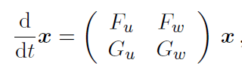
Neuronal Dynamics – 3.3 Detour. Stability of fixed points
Fixed point at
At fixed point
zoom in:

Slide 54

Neuronal Dynamics – 3.3 Detour. Stability of fixed points
Linear matrix equation
Search for solution
Two solution with Eigenvalues

Slide 55
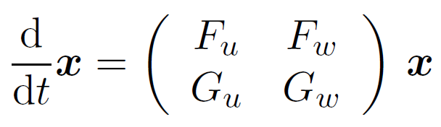
Neuronal Dynamics – 3.3 Detour. Stability of fixed points
Linear matrix equation
Stability requires:
Search for solution
Two solution with Eigenvalues
and

Slide 56
Neuronal Dynamics – 3.3 Detour. Stability of fixed points
stimulus
w
I(t)=I₀
u
unstable
saddle
stable

Slide 57
Neuronal Dynamics – 3.3 Detour. Stability of fixed points
2-dimensional equation
Now Back:
Application to our
neuron model
Stability characterized by Eigenvalues of linearized equations

Slide 58
Neuronal Dynamics – 3.3. FitzHugh-Nagumo Model: Constant input
w
w-nullcline
I(t)=I₀
u
Intersection point (fixed point)
moves
changes Stability
u-nullcline

Slide 59
Neuronal Dynamics – 3.3. FitzHugh-Nagumo Model: Constant input
w
w-nullcline
I(t)=I₀
u
Intersection point (fixed point)
moves
changes Stability
u-nullcline

Slide 60
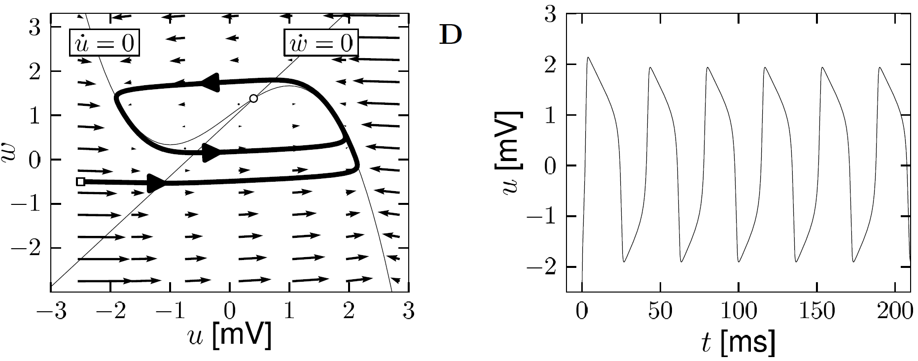
Neuronal Dynamics – 3.3. FitzHugh-Nagumo Model : Constant input
Image:
Neuronal Dynamics,
Gerstner et al.,
CUP (2014)
FN model with
f-I curve
f
constant input: u-nullcline moves
limit cycle
I0

Slide 61
Neuronal Dynamics – Quiz 3.4.
Short current pulses. In a 2-dimensional neuron model, the effect of a delta current pulse can be analyzed
[ ] By moving the u-nullcline vertically upward
[ ] By moving the w-nullcline vertically upward
[ ] As a potential change in the stability or number of the fixed point(s)
[ ] As a new initial condition
[ ] By following the flow of arrows in the appropriate phase plane diagram
B. Constant current. In a 2-dimensional neuron model, the effect of a constant current can be analyzed
[ ] By moving the u-nullcline vertically upward
[ ] By moving the w-nullcline vertically upward
[ ] As a potential change in the stability or number of the fixed point(s)
[ ] By following the flow of arrows in the appropriate phase plane diagram

Slide 62
Computer exercise now
Can we understand the dynamics of the 2D model?
The END for today
Now: computer exercises
Type I and type II models
ramp input/
constant input
f-I curve
f-I curve
f
f
I0
I0
I0

